Slide 1

CHAPTER 10
THEORY OF GRAPHS AND TREES
Copyright © Cengage Learning. All rights reserved.

Slide 2

10.5
Rooted Trees
Copyright © Cengage Learning. All rights reserved.

Slide 3
Rooted Trees
In mathematics, a rooted tree is a tree in which one vertex has been distinguished from the others and is designated the root. Given any other vertex v in the tree, there is a unique path from the root to v.
The number of edges in such a path is called the level of v, and the height of the tree is the length of the longest such path. It is traditional in drawing rooted trees to place the root at the top and show the branches descending from it.

Slide 4
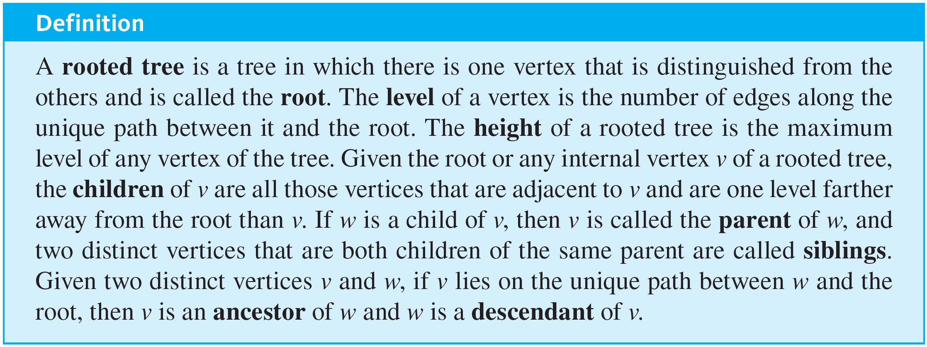
Rooted Trees

Slide 5
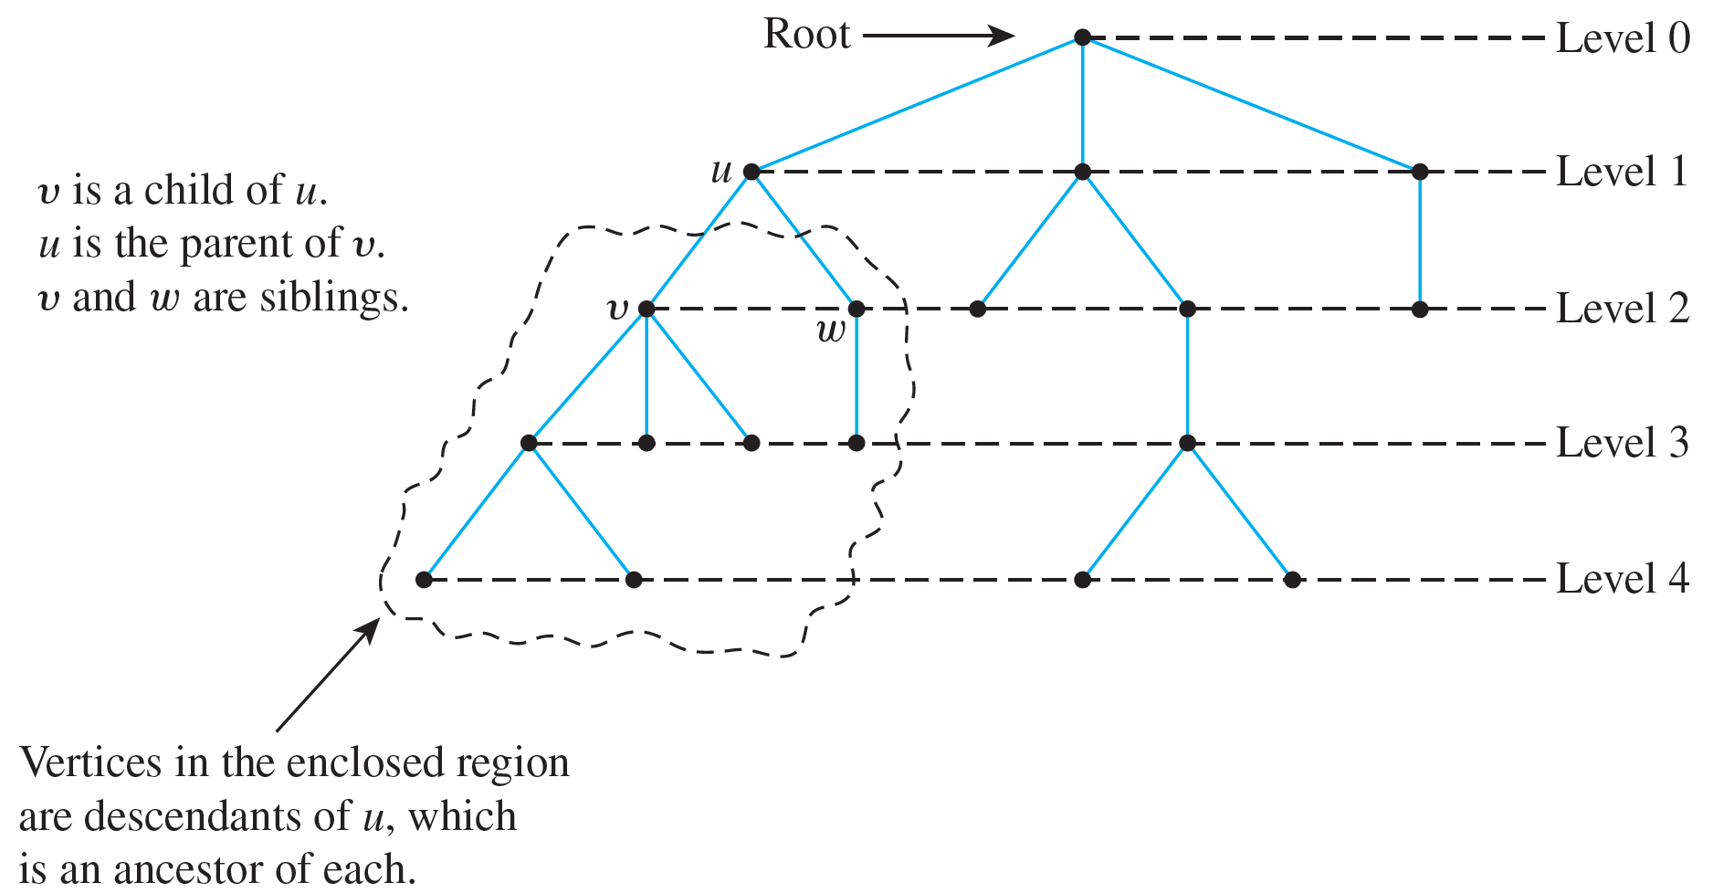
Rooted Trees
These terms are illustrated in Figure 10.5.1.
A Rooted Tree
Figure 10.5.1

Slide 6
Example 10.5.1 – Rooted Trees
Consider the tree with root v₀ shown below.
a. What is the level of v₅?
b. What is the level of v₀?
c. What is the height of this rooted tree?
d. What are the children of v₃?
e. What is the parent of v₂?
f. What are the siblings of v₈?
g. What are the descendants of v₃?

Slide 7
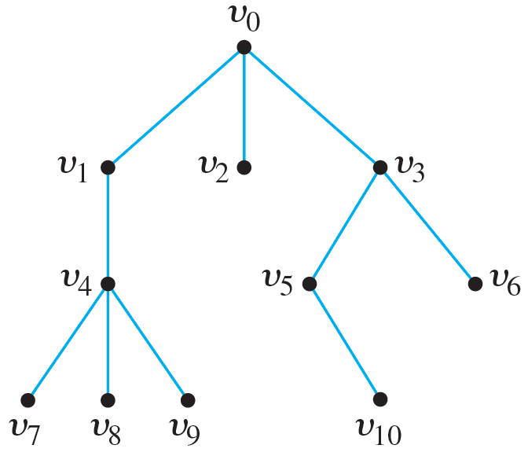
Example 10.5.1 – Rooted Trees
continued
h. How many leaves (terminal vertices) are on the tree?

Slide 8
Example 10.5.1 – Solution
a. 2 b. 0
c. 3 d. v₅ and v₆
e. v₀ f. v₇ and v₉
g. v₅, v₆, v₁₀ h. 6

Slide 9
Binary Trees

Slide 10
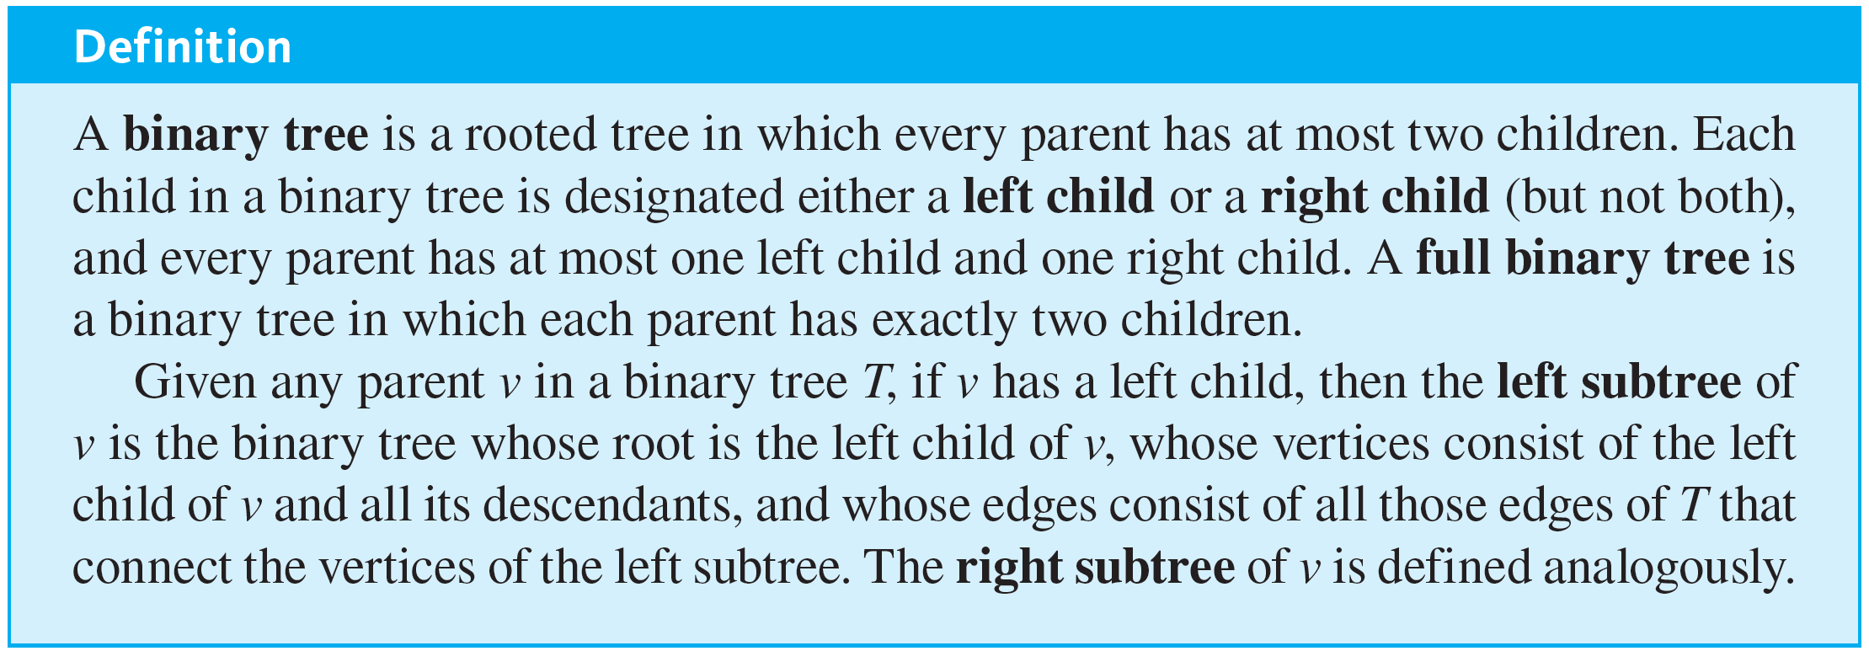
Binary Trees
When every vertex in a rooted tree has at most two children and each child is designated either the (unique) left child or the (unique) right child, the result is a binary tree.

Slide 11
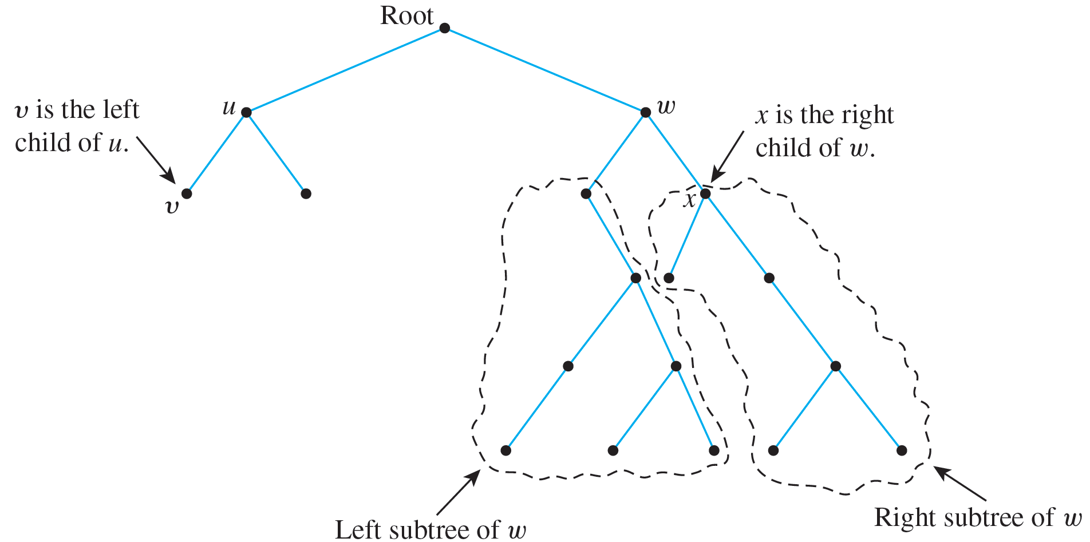
Binary Trees
These terms are illustrated in Figure 10.5.2.
A Binary Tree
Figure 10.5.2

Slide 12
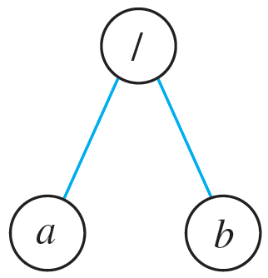
Example 10.5.2 – Representation of Algebraic Expressions
Binary trees are used in many ways in computer science. One use is to represent algebraic expressions with arbitrary nesting of balanced parentheses. For instance, the following (labeled) binary tree represents the expression a ∕ b: The operator is at the root and acts on the left and right children of the root in left-to-right order.

Slide 13
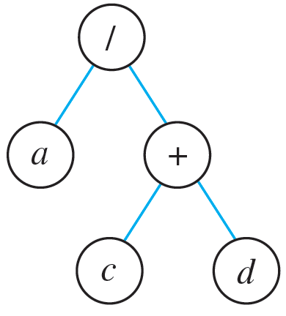
Example 10.5.2 – Representation of Algebraic Expressions
continued
More generally, the binary tree shown below represents the expression a ∕ (c + d). In such a representation, the internal vertices are arithmetic operators, the leaves are variables, and the operator at each vertex acts on its left and right subtrees in left-to-right order.
Draw a binary tree to represent the expression ((a − b) · c) + (d ∕ e).

Slide 14
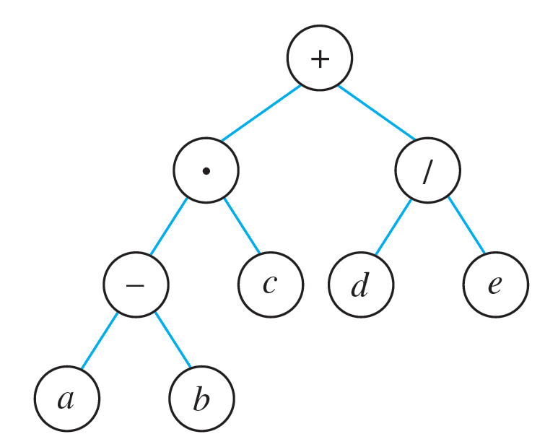
Example 10.5.2 – Solution

Slide 15
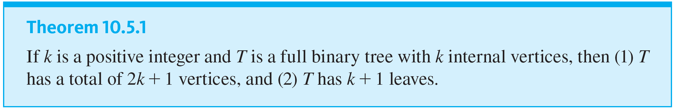
Binary Trees
An interesting theorem about binary trees says that if you know the number of internal vertices of a full binary tree, then you can calculate both the total number of vertices and the number of leaves, and conversely. More specifically, a full binary tree with k internal vertices has a total of 2k + 1 vertices of which k + 1 are leaves.

Slide 16
Example 10.5.3 – Determining Whether a Certain Full Binary Tree Exists
Is there a full binary tree that has 10 internal vertices and 13 terminal vertices?

Slide 17
Example 10.5.3 – Solution
No. By Theorem 10.5.1, a full binary tree with 10 internal vertices has 10 + 1 = 11 leaves, not 13.

Slide 18


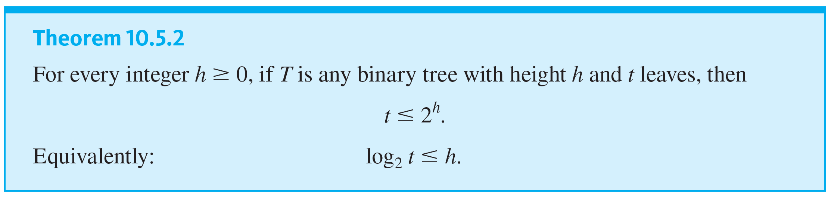
Binary Trees
Another interesting theorem about binary trees specifies the maximum number of leaves of a binary tree of a given height. Specifically, the maximum number of leaves of a binary tree of height h is
Another way to say this is that a binary tree with t leaves has height of at least

Slide 19
Example 10.5.4 – Determining Whether a Certain Binary Tree Exists
Is there a binary tree that has height 5 and 38 leaves?

Slide 20

Example 10.5.4 – Solution
No. By Theorem 10.5.2, any binary tree T with height 5 has at most
leaves, so such a tree cannot have 38 leaves.

Slide 21
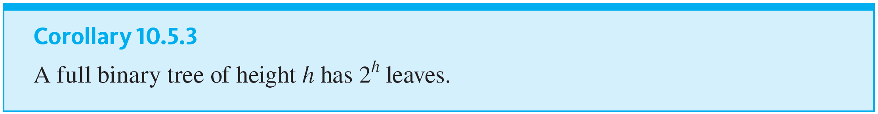
Binary Trees

Slide 22
Binary Search Trees

Slide 23
Binary Search Trees
A binary search tree is a kind of binary tree in which data records, such as customer information, can be stored, searched, and processed very efficiently. To place records into a binary search tree, it must be possible to arrange them in a total order.
In case they do not have a natural total order of their own, an element of a totally ordered set, such as a number or a word and called a key, may be added to each record. The keys are inserted into the vertices of the tree and provide access to the records to which they are attached.

Slide 24
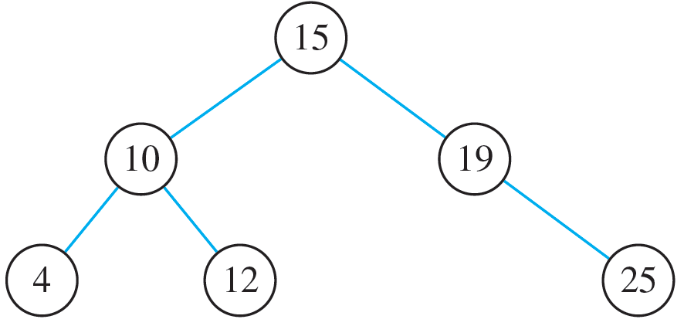
Binary Search Trees
Once it is built, a binary search tree has the following property: for every internal vertex v, all the keys in the left subtree of v are less than the key in v, and all the keys in the right subtree of v are greater than the key in v.
For example, check that the following is a binary search tree for the set of records with the following keys: 15, 10, 19, 25, 12, 4.

Slide 25
Binary Search Trees
To build a binary search tree, start by making a root and insert a key into it.
To add a new key, compare it to the key at the root. If the new key is less than the key at the root, give the root a left child and insert the new key into it.
If the key is greater than the key at the root, give the root a right child and insert the new key into it.

Slide 26
Binary Search Trees
After the first couple of keys have been added, the root and other vertices may already have left and right children.
So to add a key at a subsequent stage, work down the tree to find a place to put the new key, starting at the root and either moving left or right depending on whether the new key is less or greater than the key at the vertex to which it is currently being compared.

Slide 27
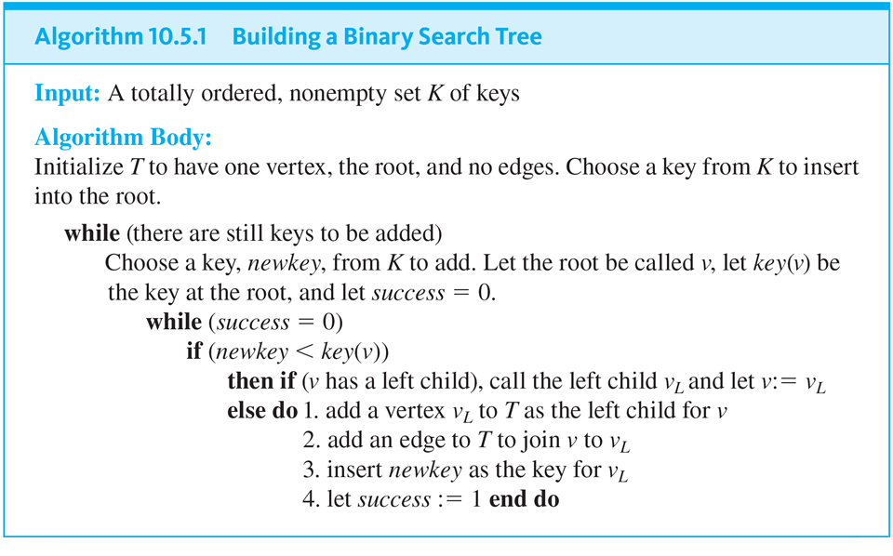
Binary Search Trees

Slide 28
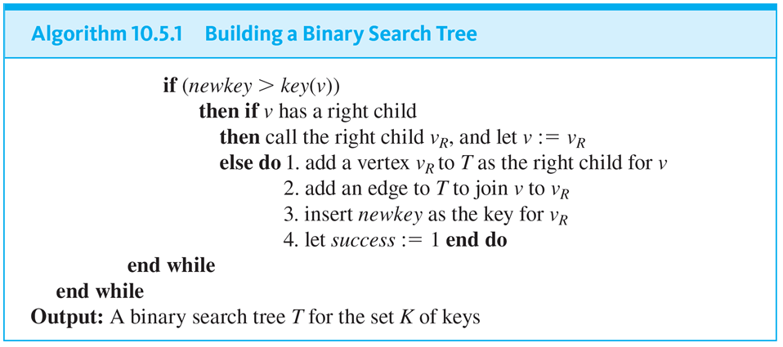
Binary Search Trees
continued

Slide 29
Example 10.5.5 – Steps for Building a Binary Search Tree
Go through the steps to build a binary search tree for the keys 15, 10, 19, 25, 12, 4, and insert the keys in the order in which they are listed. For simplicity, use the same names for the vertices and their associated keys.

Slide 30
Example 10.5.5 – Solution
Insert 15: Make 15 the root.
Insert 10: Compare 10 to 15.
Since 10 < 15 and 15 does not have a left child, make 10 the left child of 15 and add an edge joining 15 and 10.
Insert 19: Compare 19 to 15.
Since 19 > 15 and 15 does not have a right child, make 19 the right child of 15 and add an edge joining 15 and 19.

Slide 31
Example 10.5.5 – Solution
continued
Insert 25: Compare 25 to 15.
Since 25 > 15 and 15 has a right child, namely 19, compare 25 to 19.
Since 25 > 19 and 19 does not have a right child, make 25 the right child of 19 and add an edge joining 19 and 25.
Insert 12: Compare 12 to 15.
Since 12 < 15 and 15 has a left child, namely 10, compare 12 to 10.
Since 12 > 10 and 10 does not have a right child, make 12 the right child of 10 and add an edge joining 10 and 12.

Slide 32
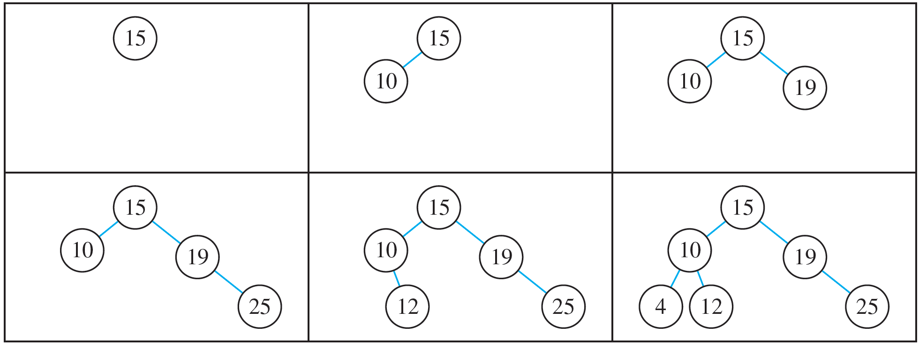
Example 10.5.5 – Solution
continued
Insert 4: Compare 4 to 15.
Since 4 < 15 and 15 has a left child, namely 10, compare 4 to 10.
Since 4 < 10 and 10 does not have a left child, make 4 the left child of 10 and add an edge joining 10 and 4.
The sequence of steps is shown in the following diagrams.

